Slide 1
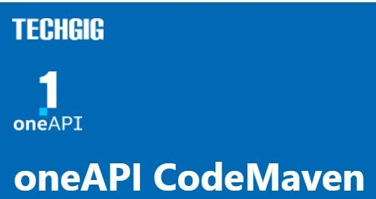

Theme: Montecarlo Simulation
Team Name: ByteFabrik
Team Members: Aniket Kumar

Slide 2
Problem Statement
Monte Carlo Simulation using SYCL

Slide 3
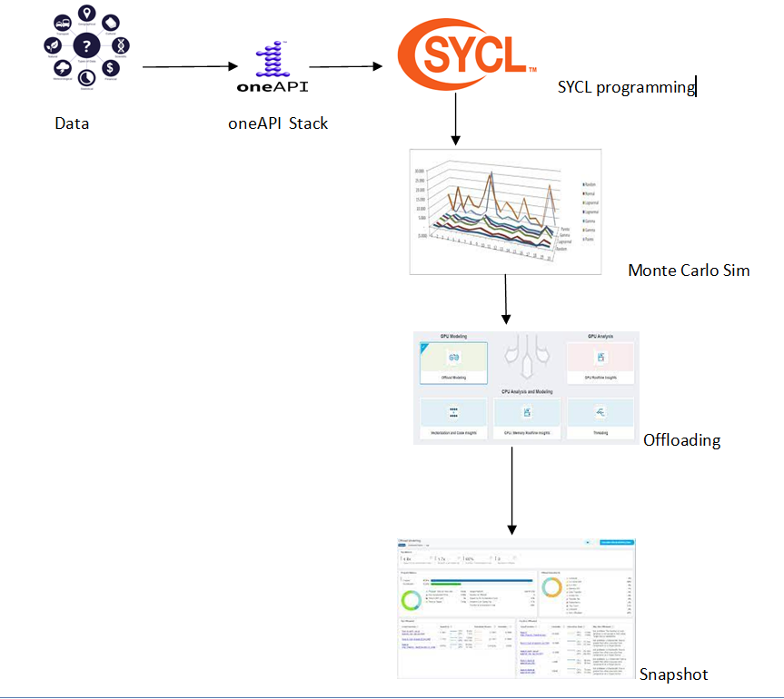
Tech Architecture

Slide 4
What we are doing
Monte Carlo Simulation using the Black-Scholes formula is a mathematical model that provides an analytical solution for pricing European-style options, which are financial contracts that give the holder the right, but not the obligation, to buy (call option) or sell (put option) an underlying asset at a predetermined price (strike price) on or before a specific date (expiration date).
The formula assumes that the price of the underlying asset follows a geometric Brownian motion, which means that the rate of return on the asset is normally distributed with a constant expected return and volatility over time.
The formula calculates the theoretical value of the option by taking into account several factors,

Slide 5
What we are doing
Current price of the underlying asset (S)
Strike price of the option (K)
Time to expiration of the option (T)
Risk-free interest rate (r)
Dividend yield of the underlying asset (q)
Volatility of the underlying asset (σ)
The formula is:
C = S * N(d1) - K * e^(-rT) * N(d2)
P = K * e^(-rT) * N(-d2) - S * N(-d1)
where:
C is the call option price
P is the put option price

Slide 6
What we are doing
N(d1) and N(d2) are the cumulative normal distribution functions of the standardized variables d1 and d2, respectively, which are defined as follows:
d1 = [ln(S/K) + (r - q + σ^2/2)T] / (σ * sqrt(T))
d2 = d1 - σ * sqrt(T)
The Black-Scholes formula assumes that the underlying asset follows a lognormal distribution, which means that small changes in the price of the underlying asset have a proportional effect on the option price. However, the model has some limitations, such as assuming constant volatility and that stock prices follow a random walk, which may not always hold in real-world financial markets.

Slide 7
What we are doing
code is using SYCL standards to perform a Monte Carlo simulation to price European call options using the Black-Scholes model for multiple stocks. It takes in stock data for different dates and performs a Monte Carlo simulation to calculate the option price for each stock. The StockData class stores information about the stock for a particular date, including the date, stock name, open price, high price, low price, closing price, and trading volume.
The parse_stock_data function takes in raw stock data as a vector of strings, where each string represents data for a particular date, and parses it to create a vector of StockData objects. The data is separated by tabs, and each field is stored in the appropriate variable in the StockData object.
The black_scholes_call function takes in a StockData object, strike price, risk-free interest rate, dividend yield, volatility, and time to maturity, and uses the Black-Scholes formula to calculate the price of a European call option for the given stock.

Slide 8
What we are doing
In the main function, a loop is used to iterate over each StockData object in the stock_data vector. For each stock, a SYCL queue is created using the CPU selector, and a Monte Carlo simulation is performed to calculate the option price. The simulation is performed using the same parameters for all stocks, including the strike price, risk-free interest rate, dividend yield, volatility, time to maturity, number of simulations, and number of steps.
Inside the loop, a normal distribution is used to generate random numbers, which are stored in a vector and then transferred to a SYCL buffer. A kernel is then executed on the SYCL device, which performs the Monte Carlo simulation to calculate the option price. The result is stored in a SYCL buffer and then transferred back to the host. The relative error between the Monte Carlo simulation result and the analytical result calculated using the Black-Scholes formula is calculated and printed to the console along with the date and stock name. If the relative error is less than 1%, the result is considered good, and otherwise, the number of simulations or steps is suggested to be increased for a more accurate result.

Slide 9
Demo Video/Live Demo
https://youtu.be/zpgL6nLwRmg

Slide 10

GitHub Link
https://github.com/ani4aniket/monte-carlo-simulation-1-api
DPC++
Essentials
5

Slide 11
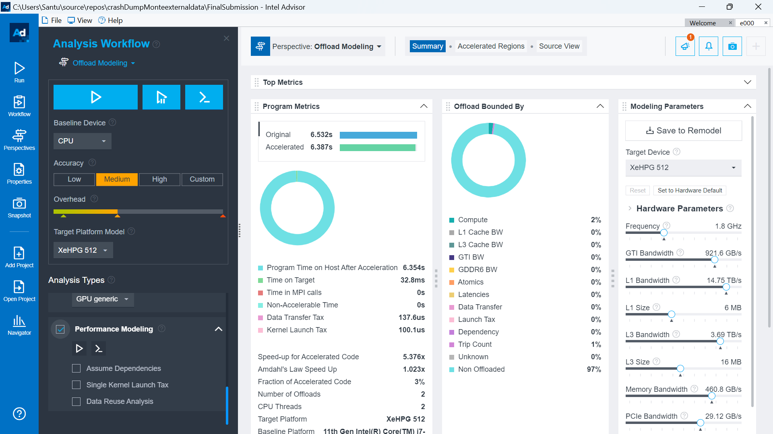
Results and Visualization
DPC++
Essentials
5

Slide 12
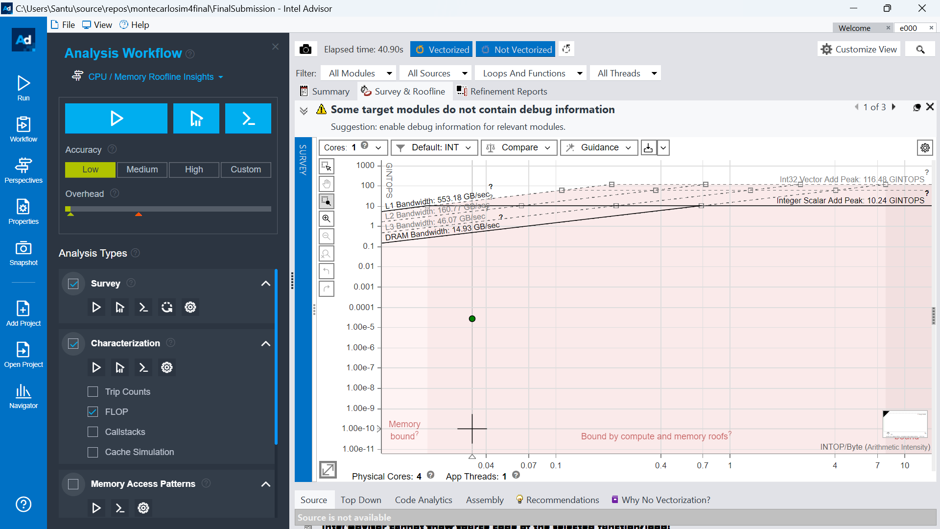
Results and Visualization
DPC++
Essentials
5

Slide 13
Results Summary
For the Monte Carlo Simulation we have taken the data points provided by Techgig and done analysis using Blacl Scholes formula and shared the result
We have written the code in SYCL
With help of Advisor we have created a roofline report for the code and deployed the same in Devcloud
We can analyse almost any code in SYCL and find performance reports generated in html and see where the codes can be improved.
We also offloaded the code to Intel Advisor so that we analyse the code we created in SYCL
oneAPI tools used
Language: SYCL
oneAPI Base toolkit
Intel DevCloud
Intel oneAPI Advisor

Slide 14

7

